Slide 1
R Programming – USArrests
-Rishiraj Patel 20220701047

Slide 2
Introduction
Objective:
The primary focus of this project is to conduct an investigative data analysis using the R programming language within the “RStudio” compiler. Through statistical analysis, data visualization, we aim to gain insights into relationships present in the US Arrests dataset.
Scope of Analysis:
1. Descriptive Statistics: Utilize R's statistical functions to generate descriptive statistics, including measures of central tendency and dispersion, providing a broad overview of the dataset.
2. Data Cleaning and Pre-processing: Address missing values, outliers, or any inconsistencies in the dataset to ensure the reliability of subsequent analyses.
3. Data Visualization: Leverage R's powerful visualization libraries, such as ggplot2, to create insightful graphs, charts, and maps. Visualizations will aid in understanding the geographical distribution of crime rates and potential correlations between different crime categories.
4. Inferential Statistics: Apply inferential statistical techniques to draw conclusions about the population from the dataset.
5. Clustering Analysis: Explore the possibility of grouping states based on crime profiles using analytical tools, providing a deeper understanding of insights within the dataset.

Slide 3
Tools and Technologies:
- R Programming Language
- RStudio Integrated Development Environment (IDE)
- Tidyverse (for data manipulation and visualization)
- ggplot2 (for advanced data visualization)
- Statistical packages in R (for inferential statistics)

Slide 4
Aim of the project
The project aims to enhance our proficiency in R programming, statistical analysis, and data visualization while contributing meaningful insights into the complex landscape of crime rates in the United States.

Slide 5
Intended outcomes of the project:
The expected outcomes of this project are multifaceted, ranging from a deeper understanding of the US Arrests dataset.

Slide 6
Dataset description:
In R, the inbuilt dataset that corresponds to US Arrests is also known as the "USArrests" built-in dataset. This dataset is built into the base R package and does not require additional installations. It provides information on crime rates in different states of the United States. The dataset is often used for introductory data analysis and statistical modelling exercises.
1. State:
- Description: The name of the state.
- Data Type: Character/String.
2. Murder:
- Description: The murder rate per 100,000 population.
- Data Type: Numeric (Continuous).

Slide 7
3. Assault:
- Description: The rate of assaults per 100,000 population.
- Data Type: Numeric (Continuous).
4. UrbanPop:
- Description: The percentage of the state's population living in urban areas.
- Data Type: Numeric (Continuous).
5. Rape:
- Description: The rate of reported rapes per 100,000 population.
- Data Type: Numeric (Continuous).
Usage:
You can access the "USArrests" dataset directly in R using the following command:
data(USArrests)

Slide 8
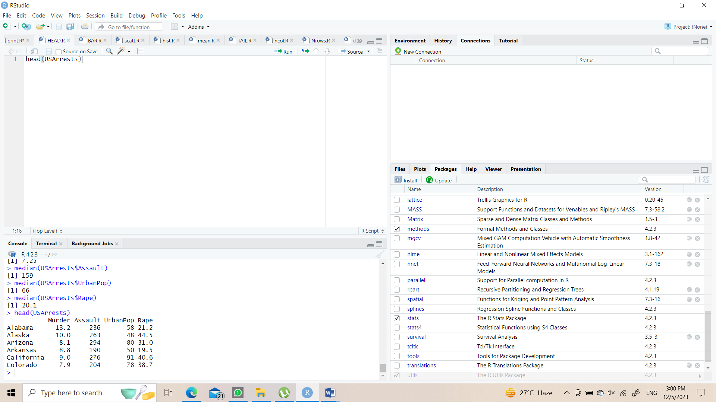
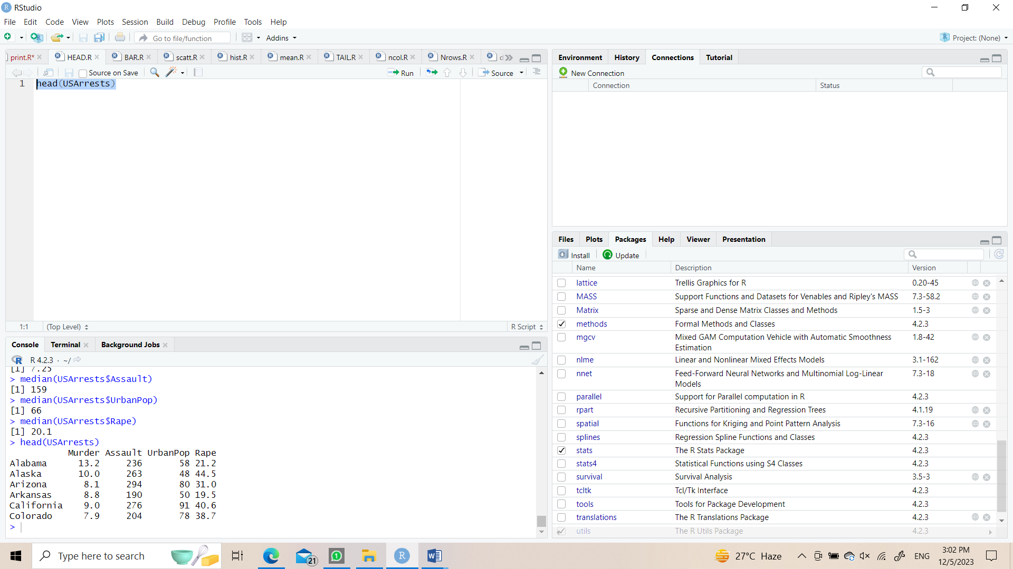
Proposed method
Input: head(USArrests)
Output:

Slide 9
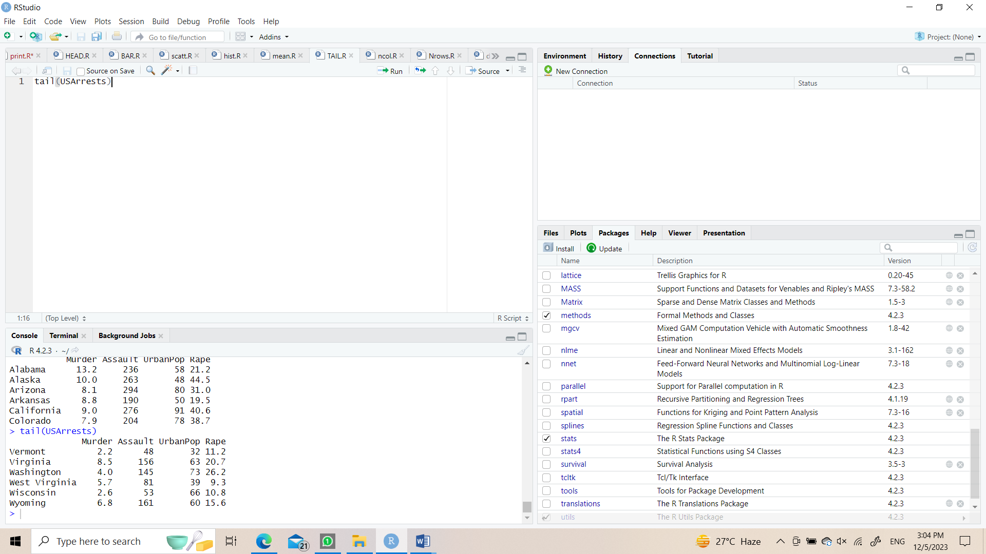
Input: tail (USArrests)
Output:

Slide 10

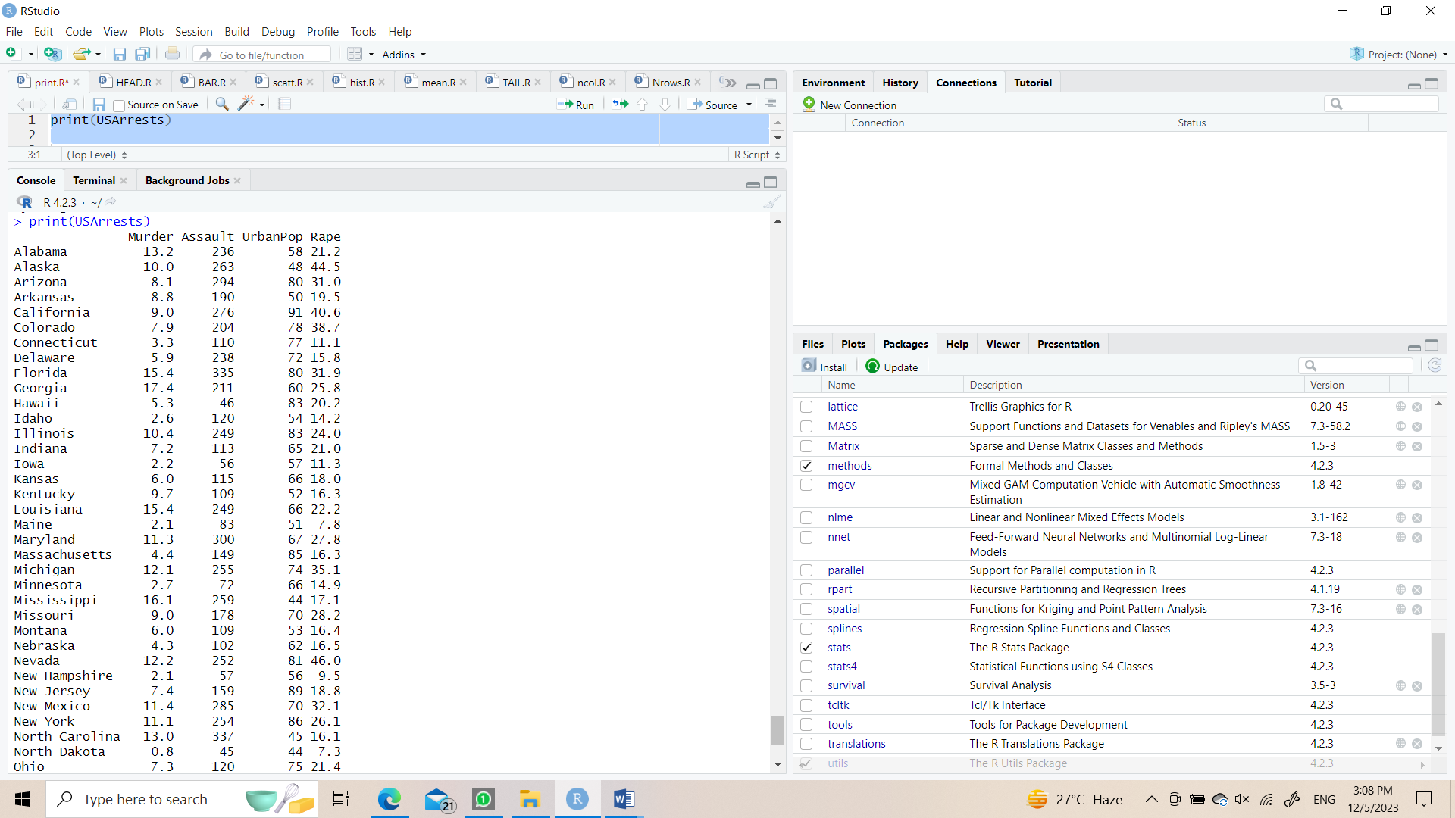
Input: print(USArrests)
Output

Slide 11
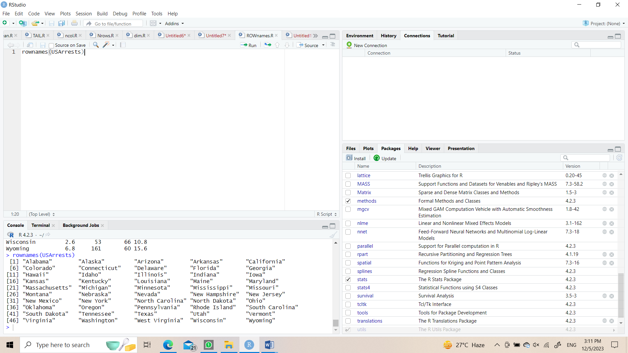

Input: rownames(USArrests)
Output:

Slide 12
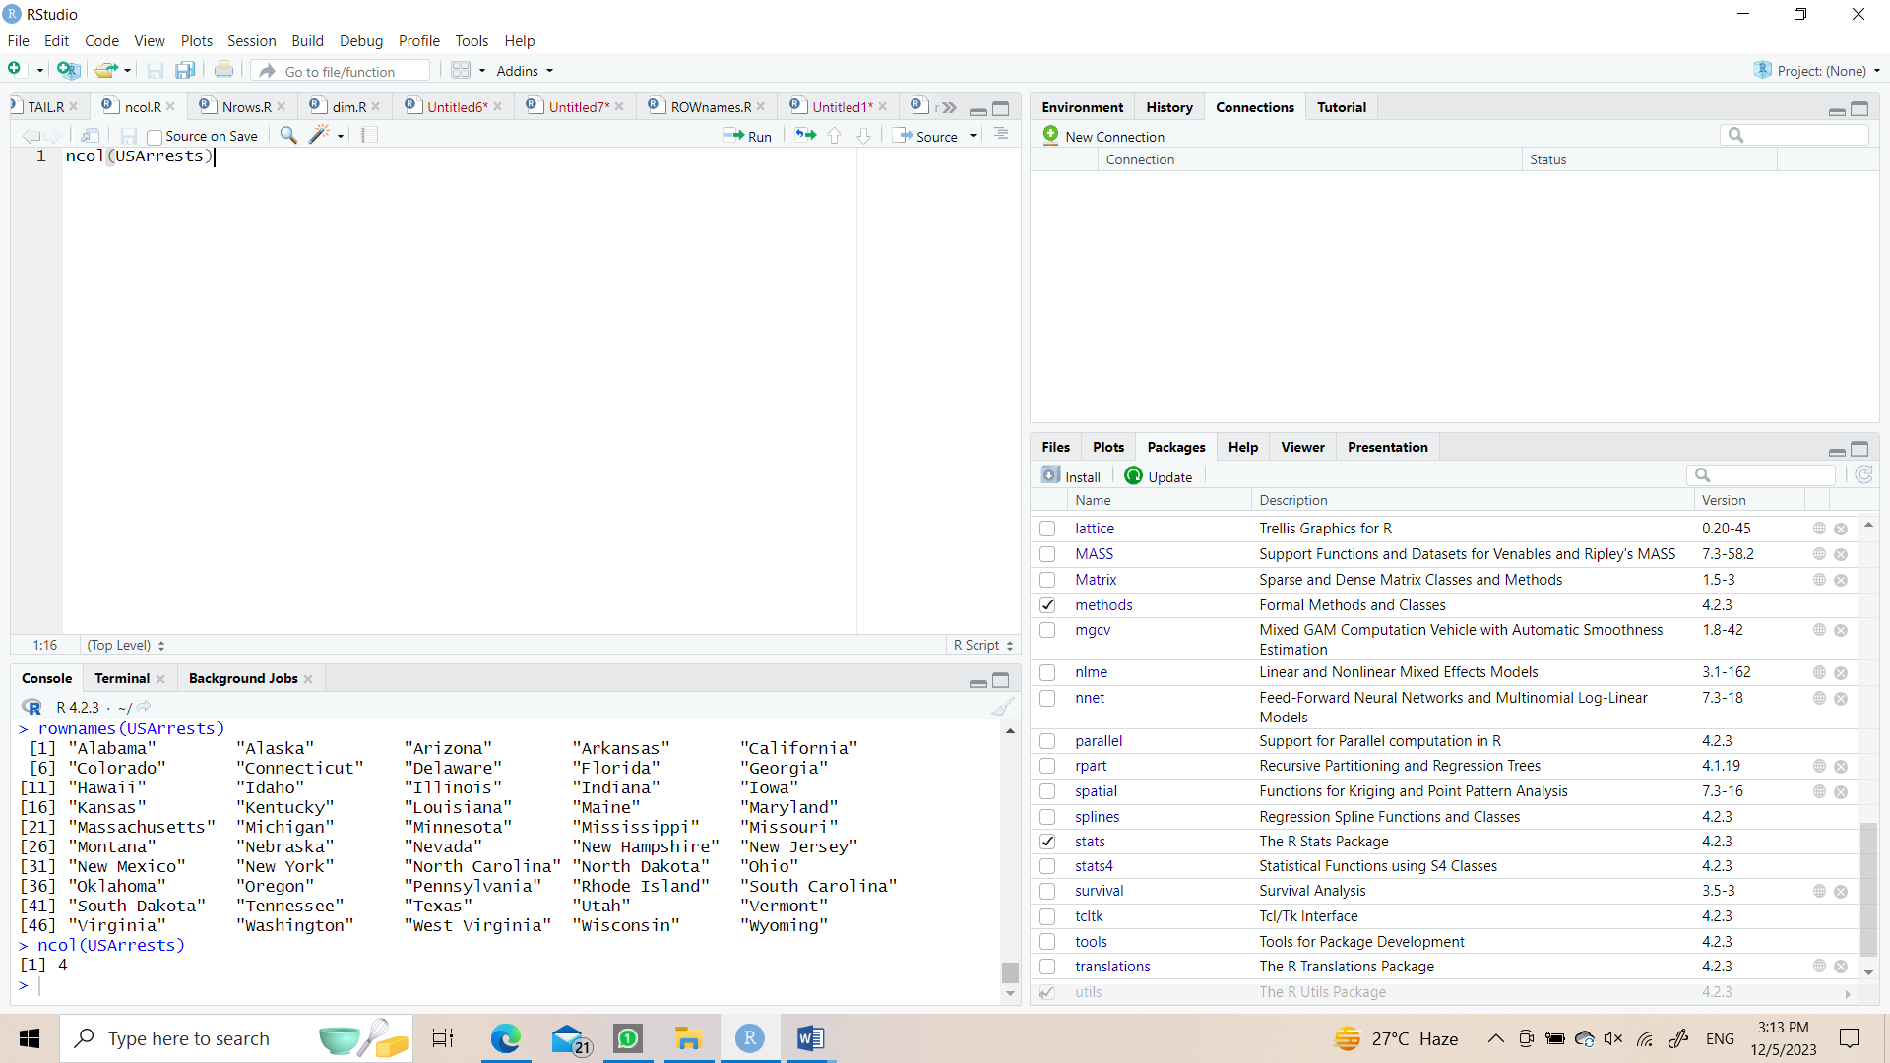

Input: ncol(USArrests)
Output:

Slide 13
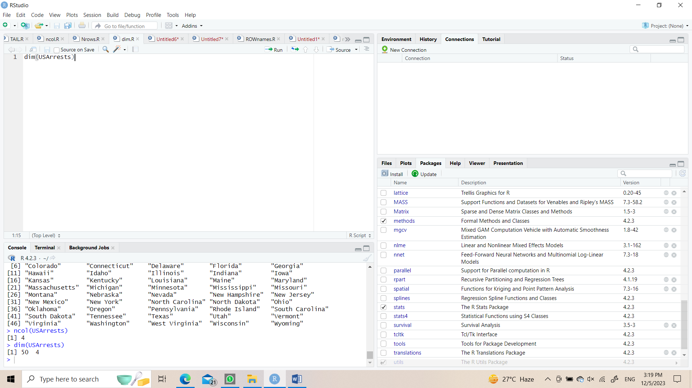
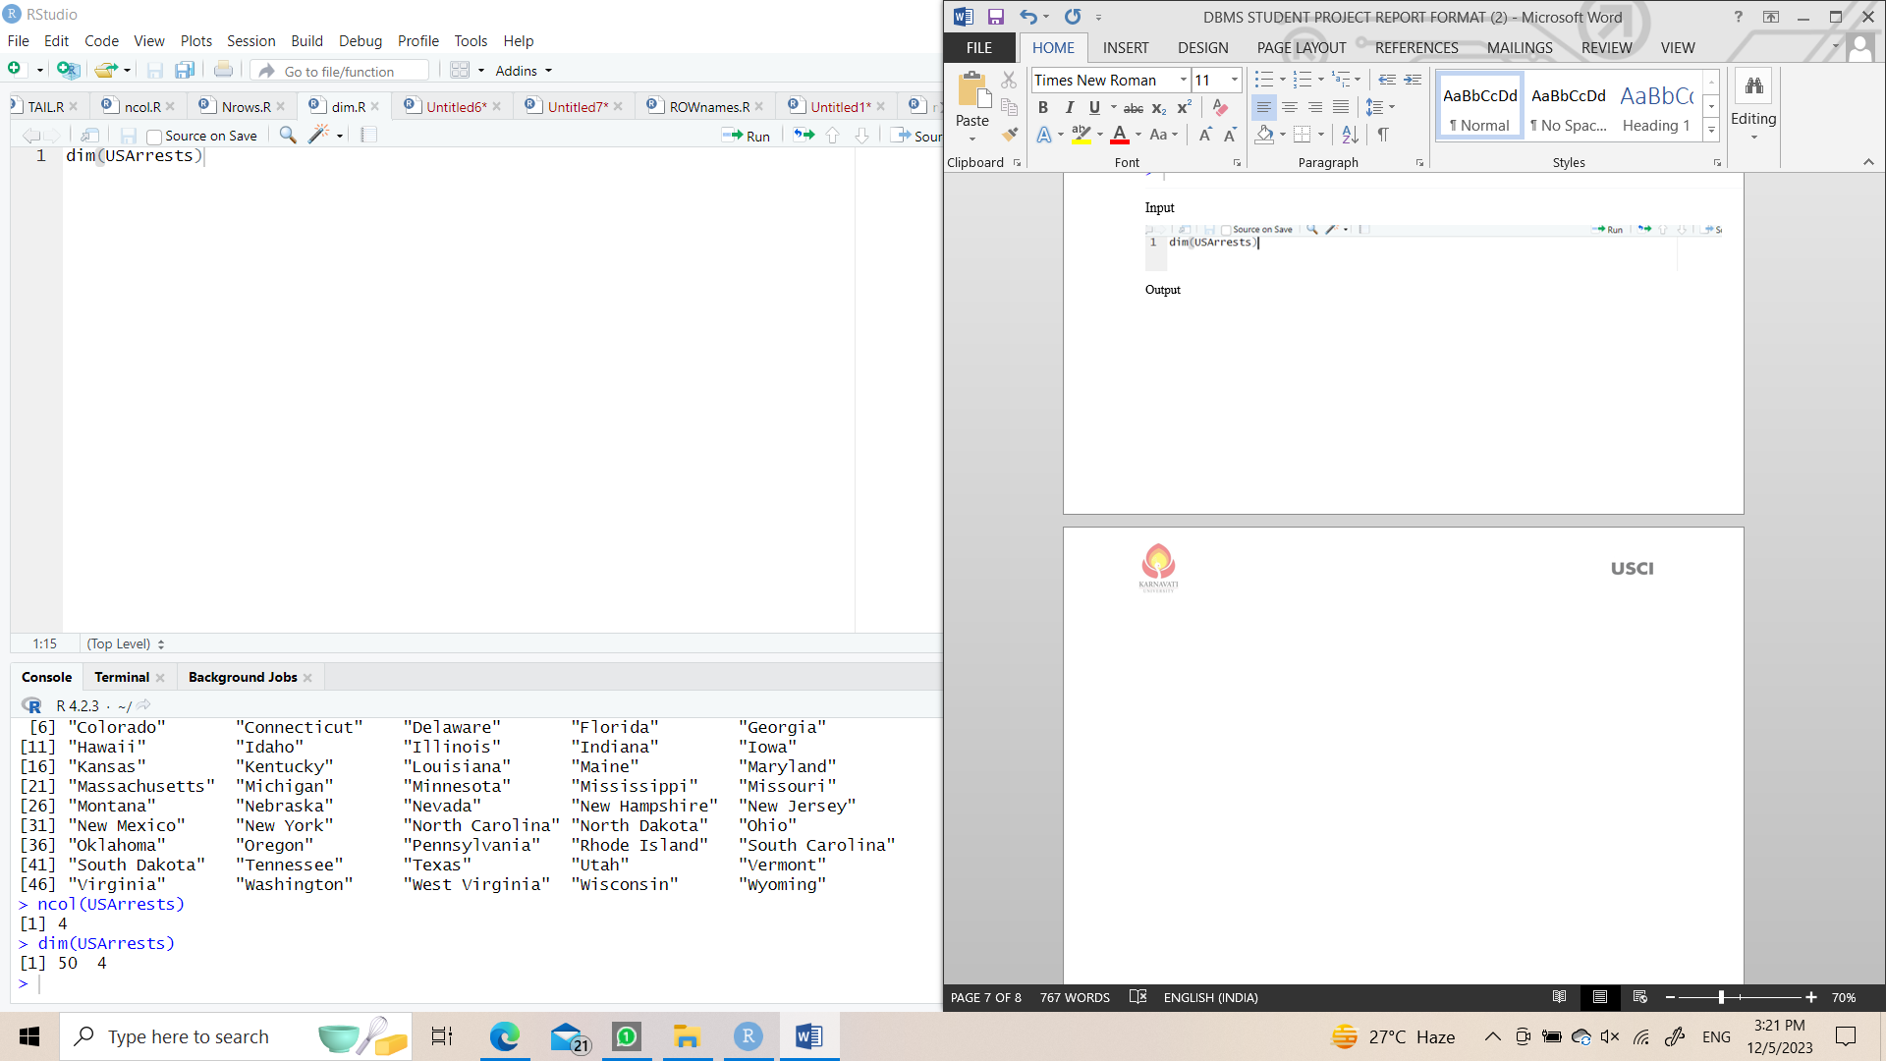
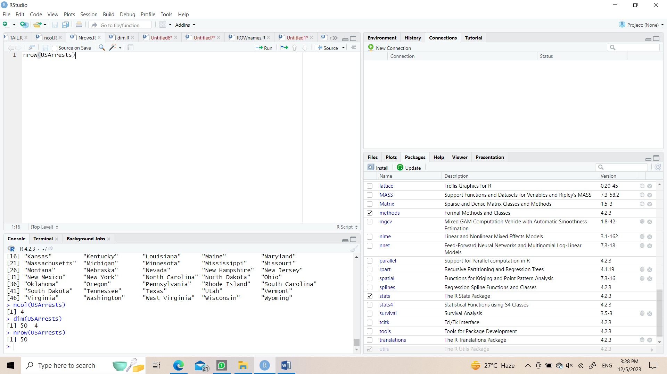
Input: dim(USArrests)
Output:
Input: nrow(USArrests)
Output:

Slide 14
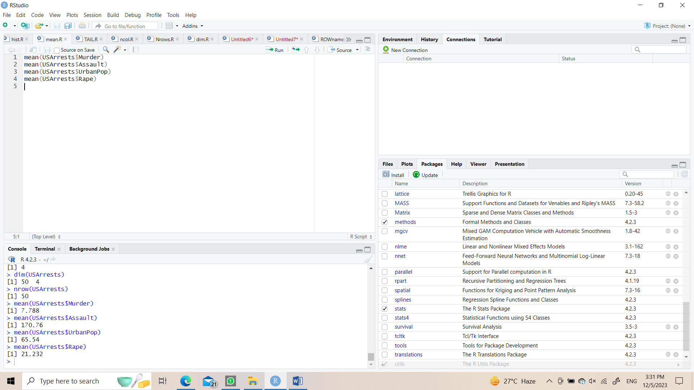
Statistical analysis
Input:
Output:

Slide 15
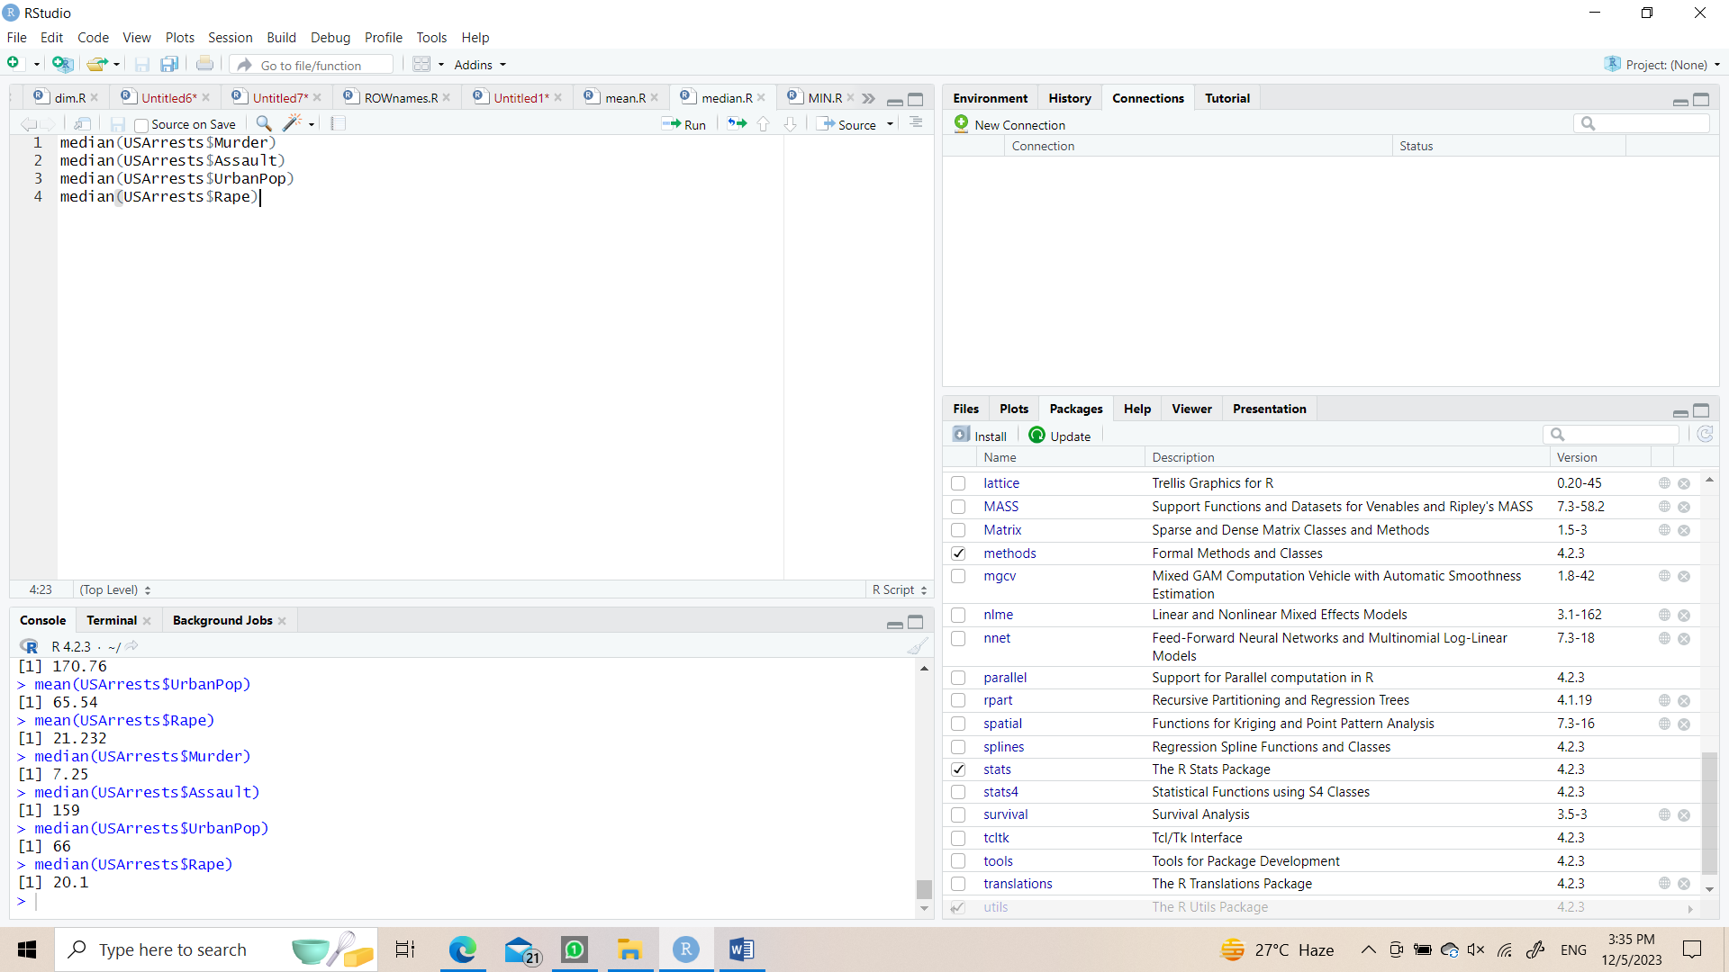
Input:
Output:

Slide 16
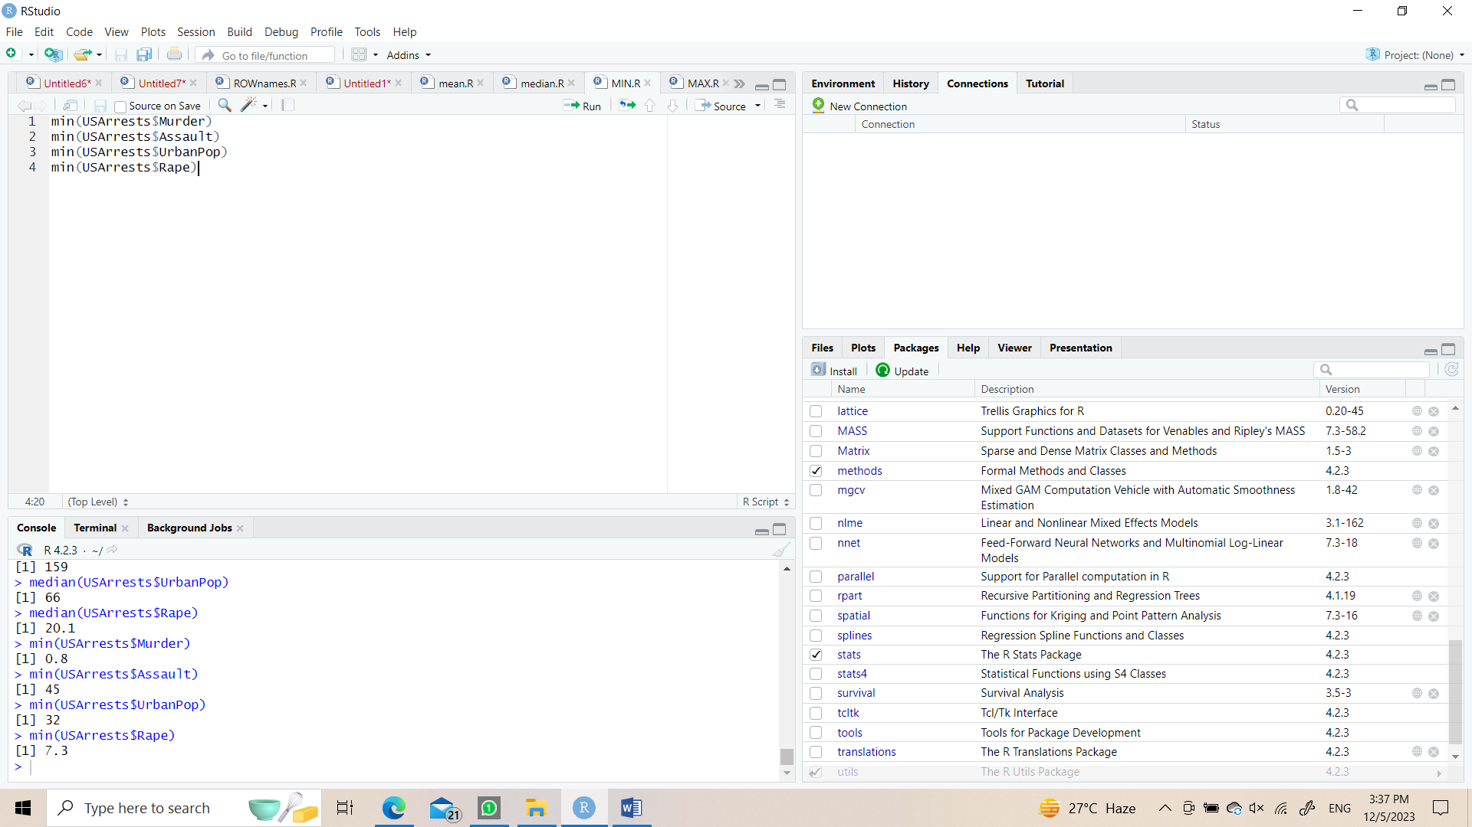
Input:
Output:

Slide 17
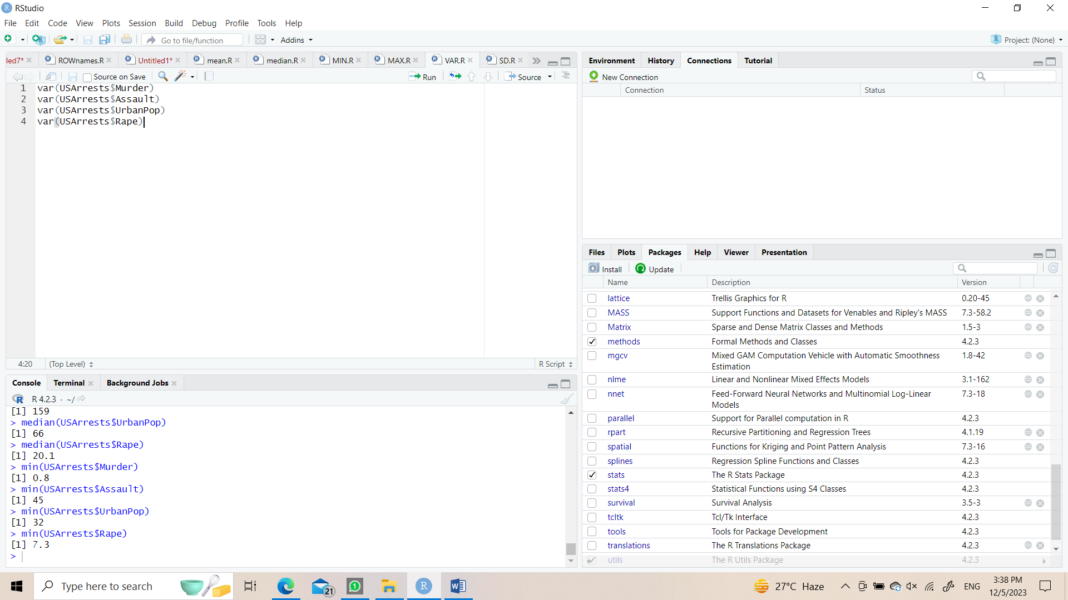
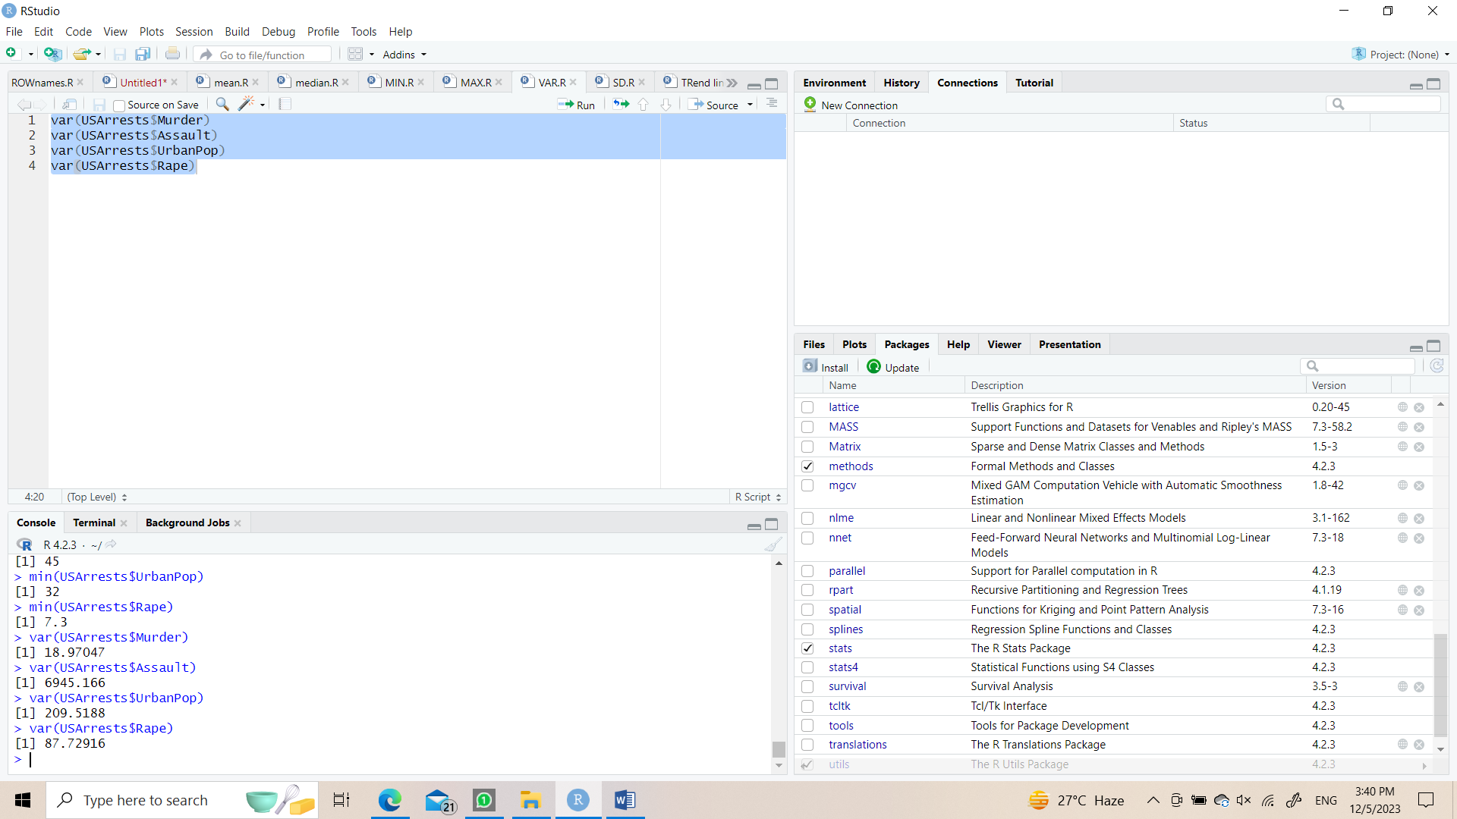
Input:
Output:

Slide 18
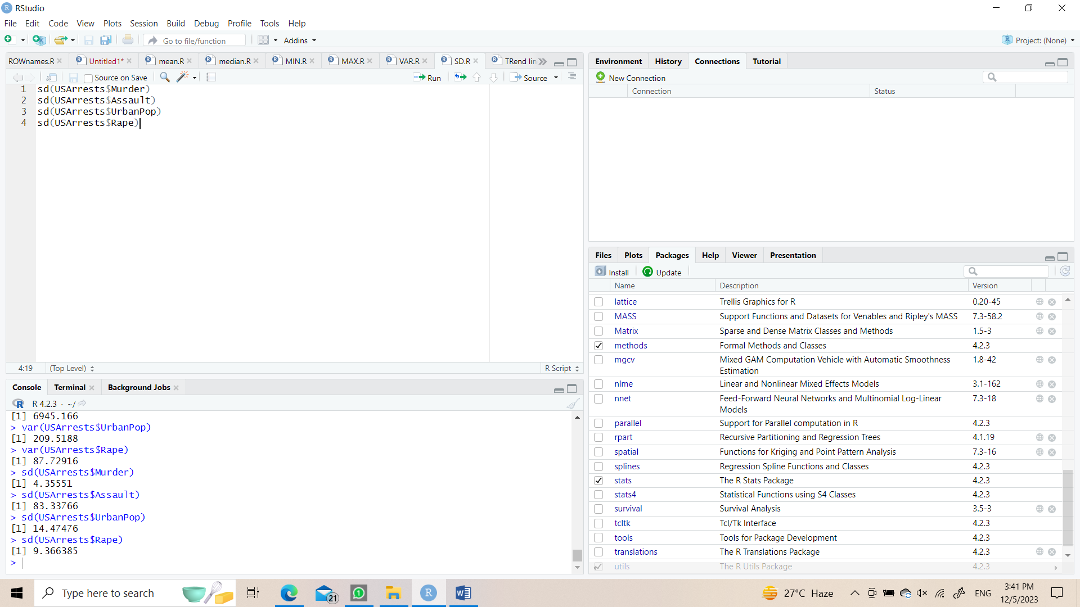
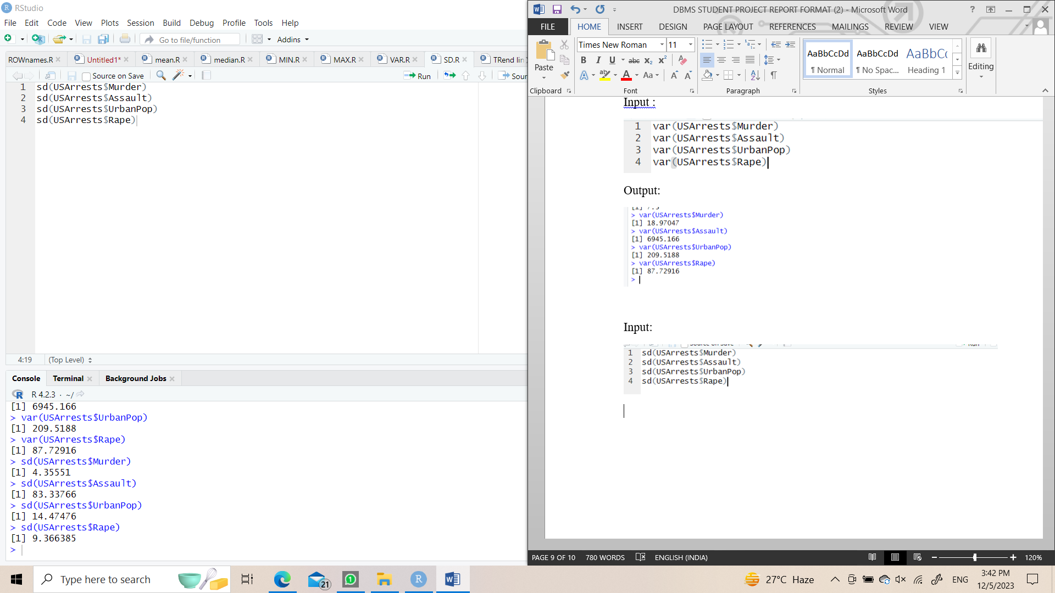
Input:
Output:

Slide 19
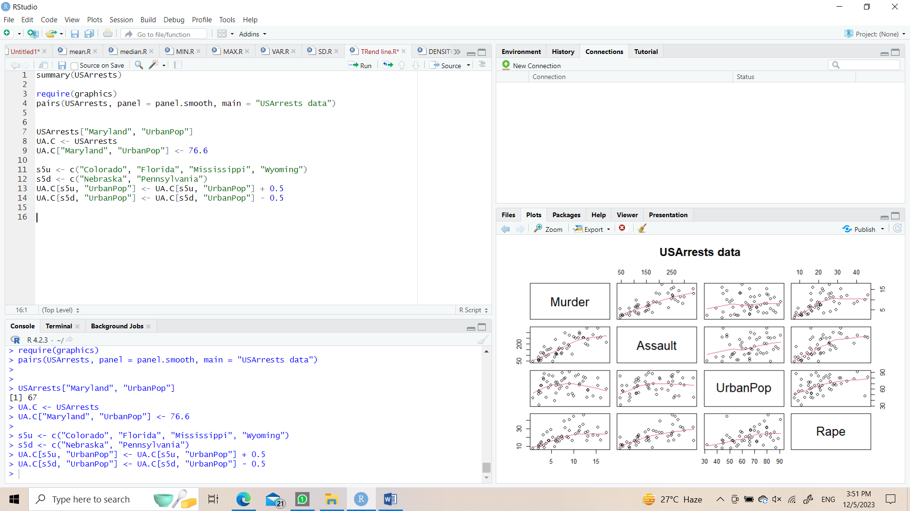
Data visualization
Input:

Slide 21
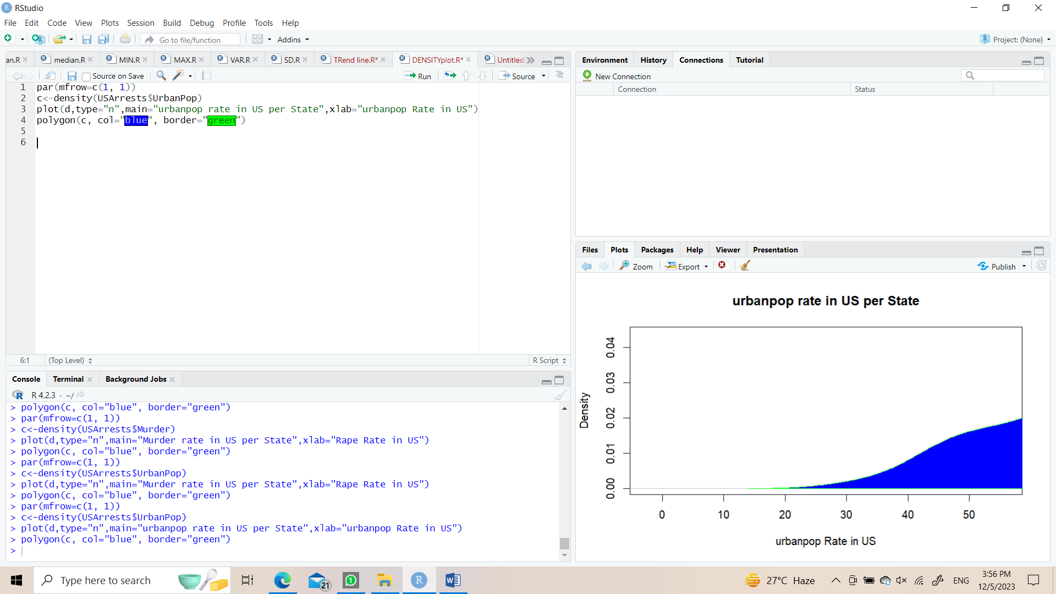
Input:
Output:

Slide 22
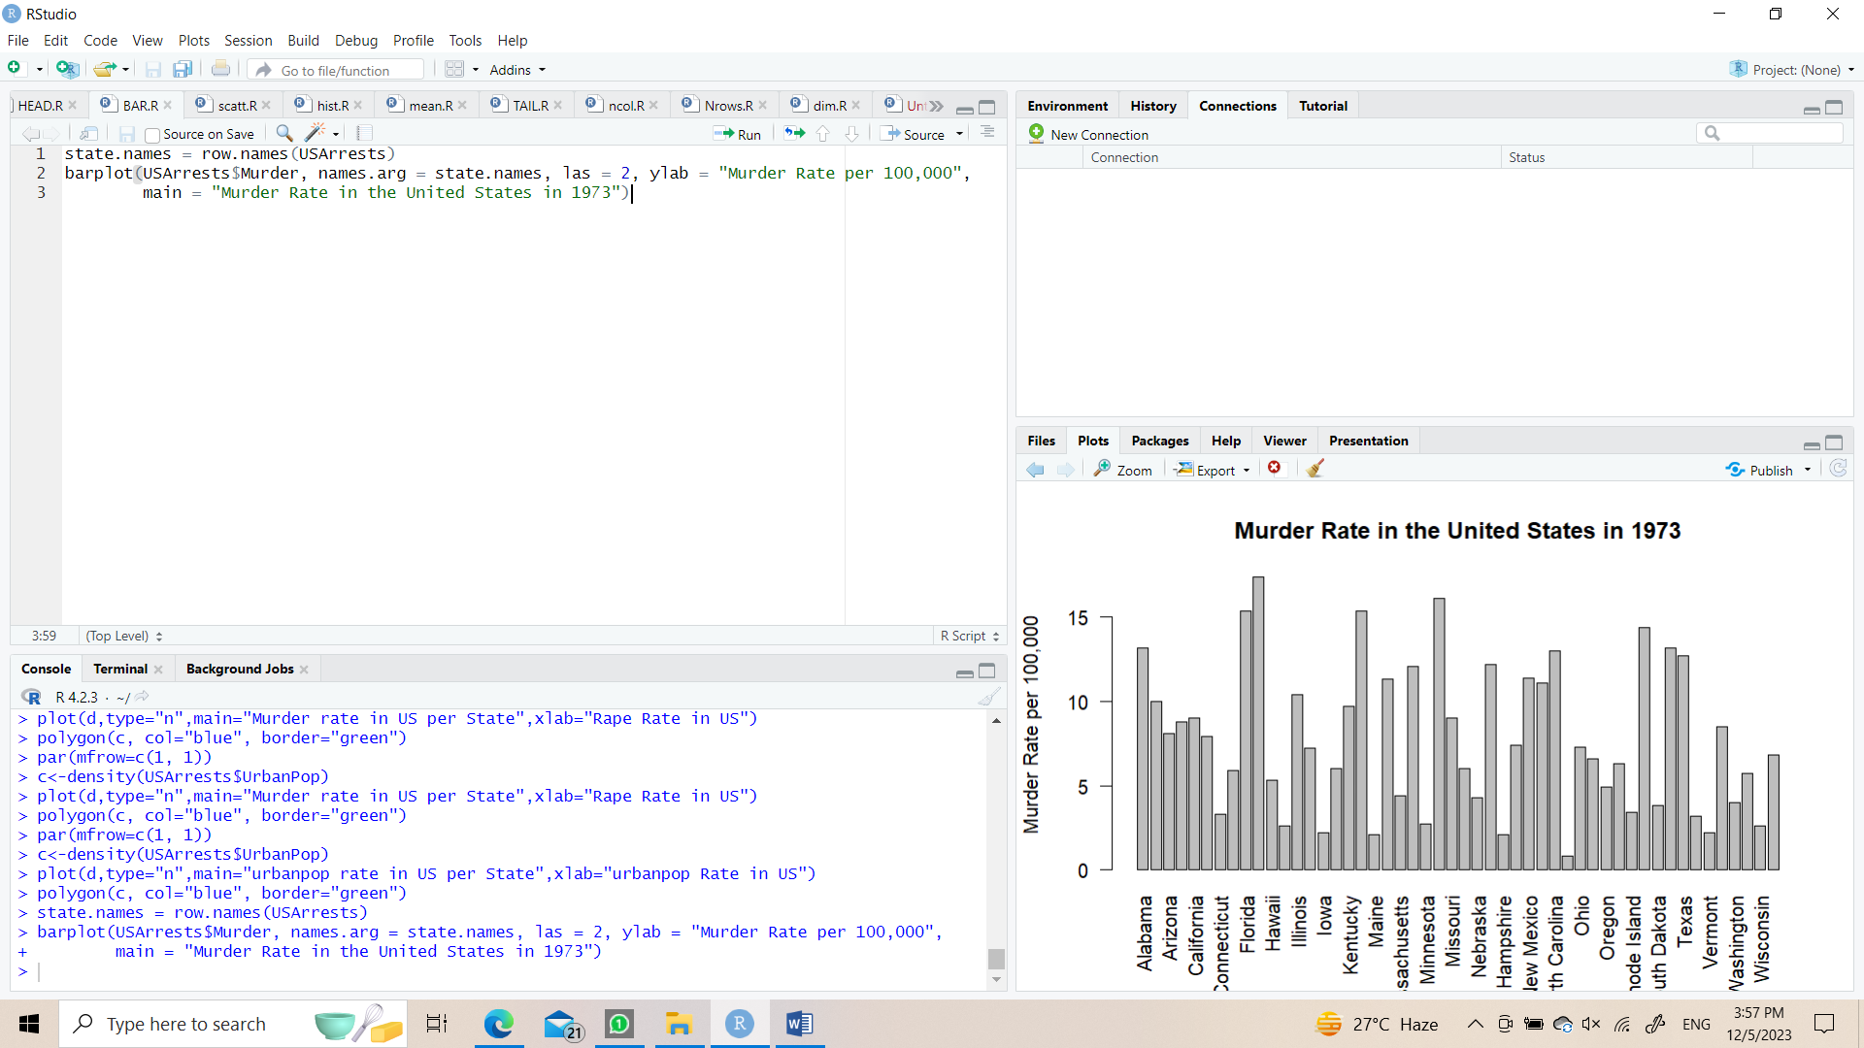
Input:
Output:

Slide 23
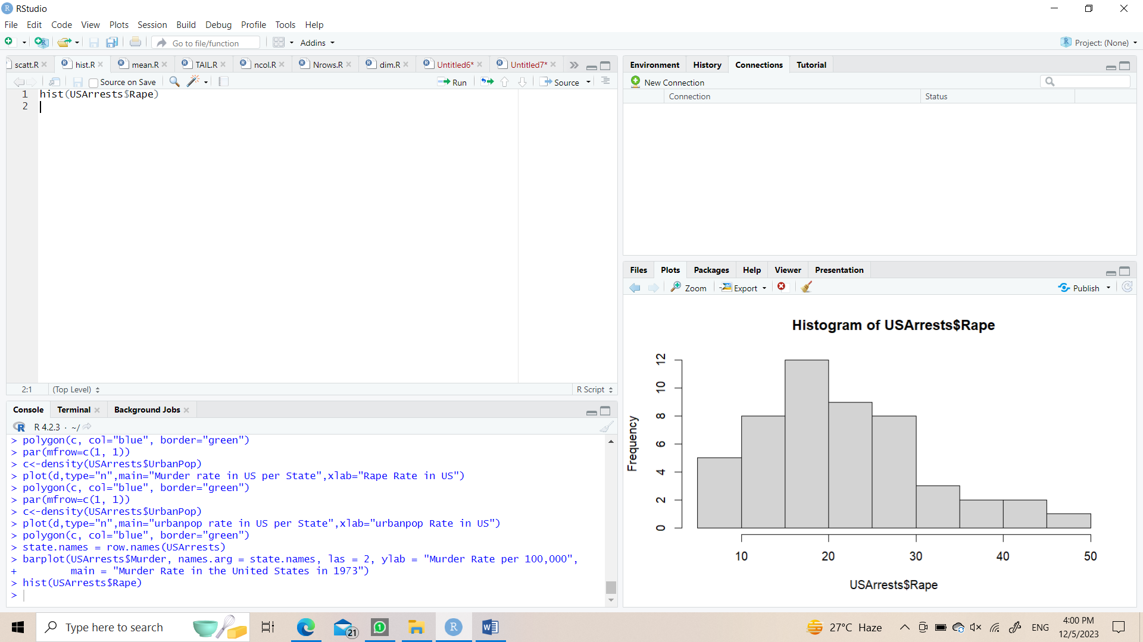
Input:
Output:

Slide 24
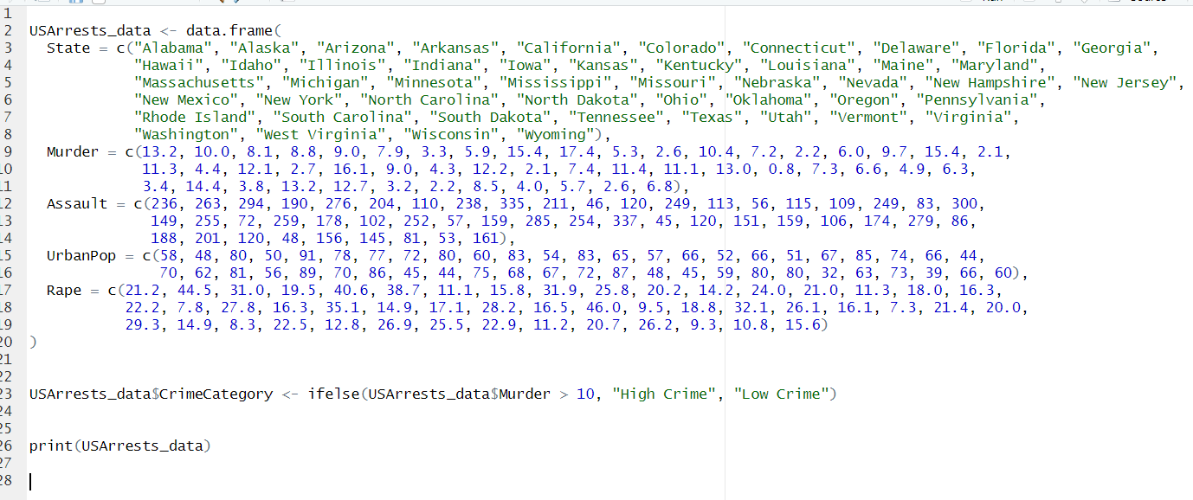
Function
Input:

Slide 25
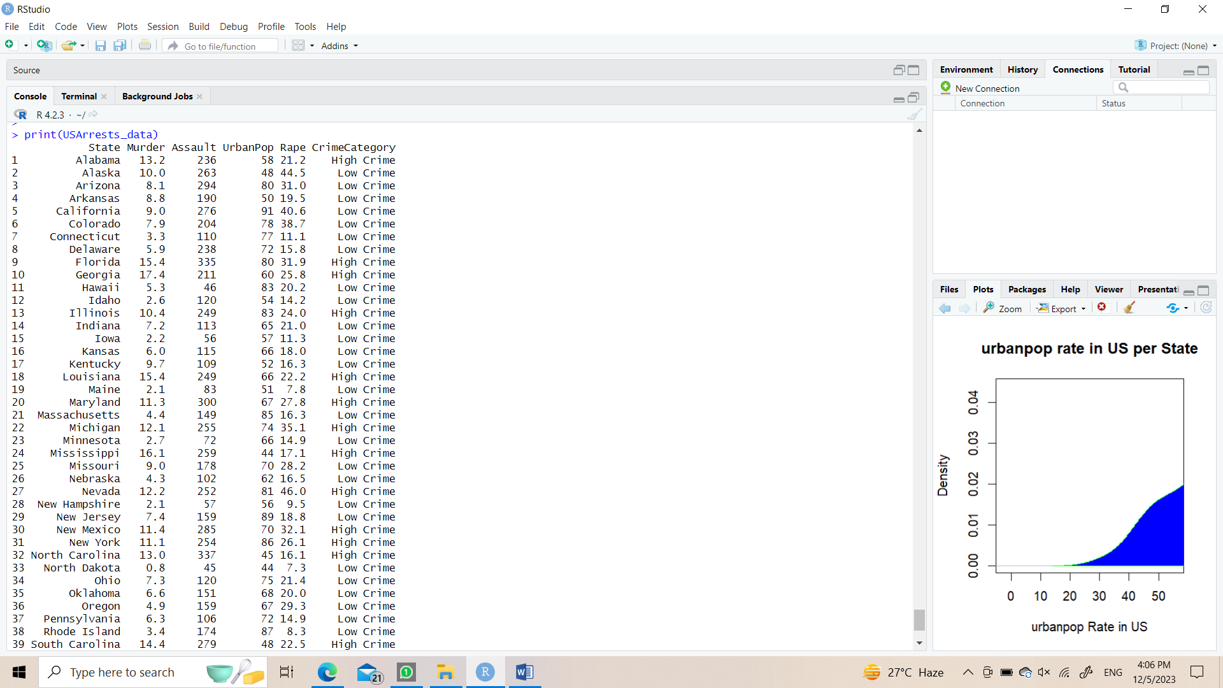
Outcome:

Slide 26
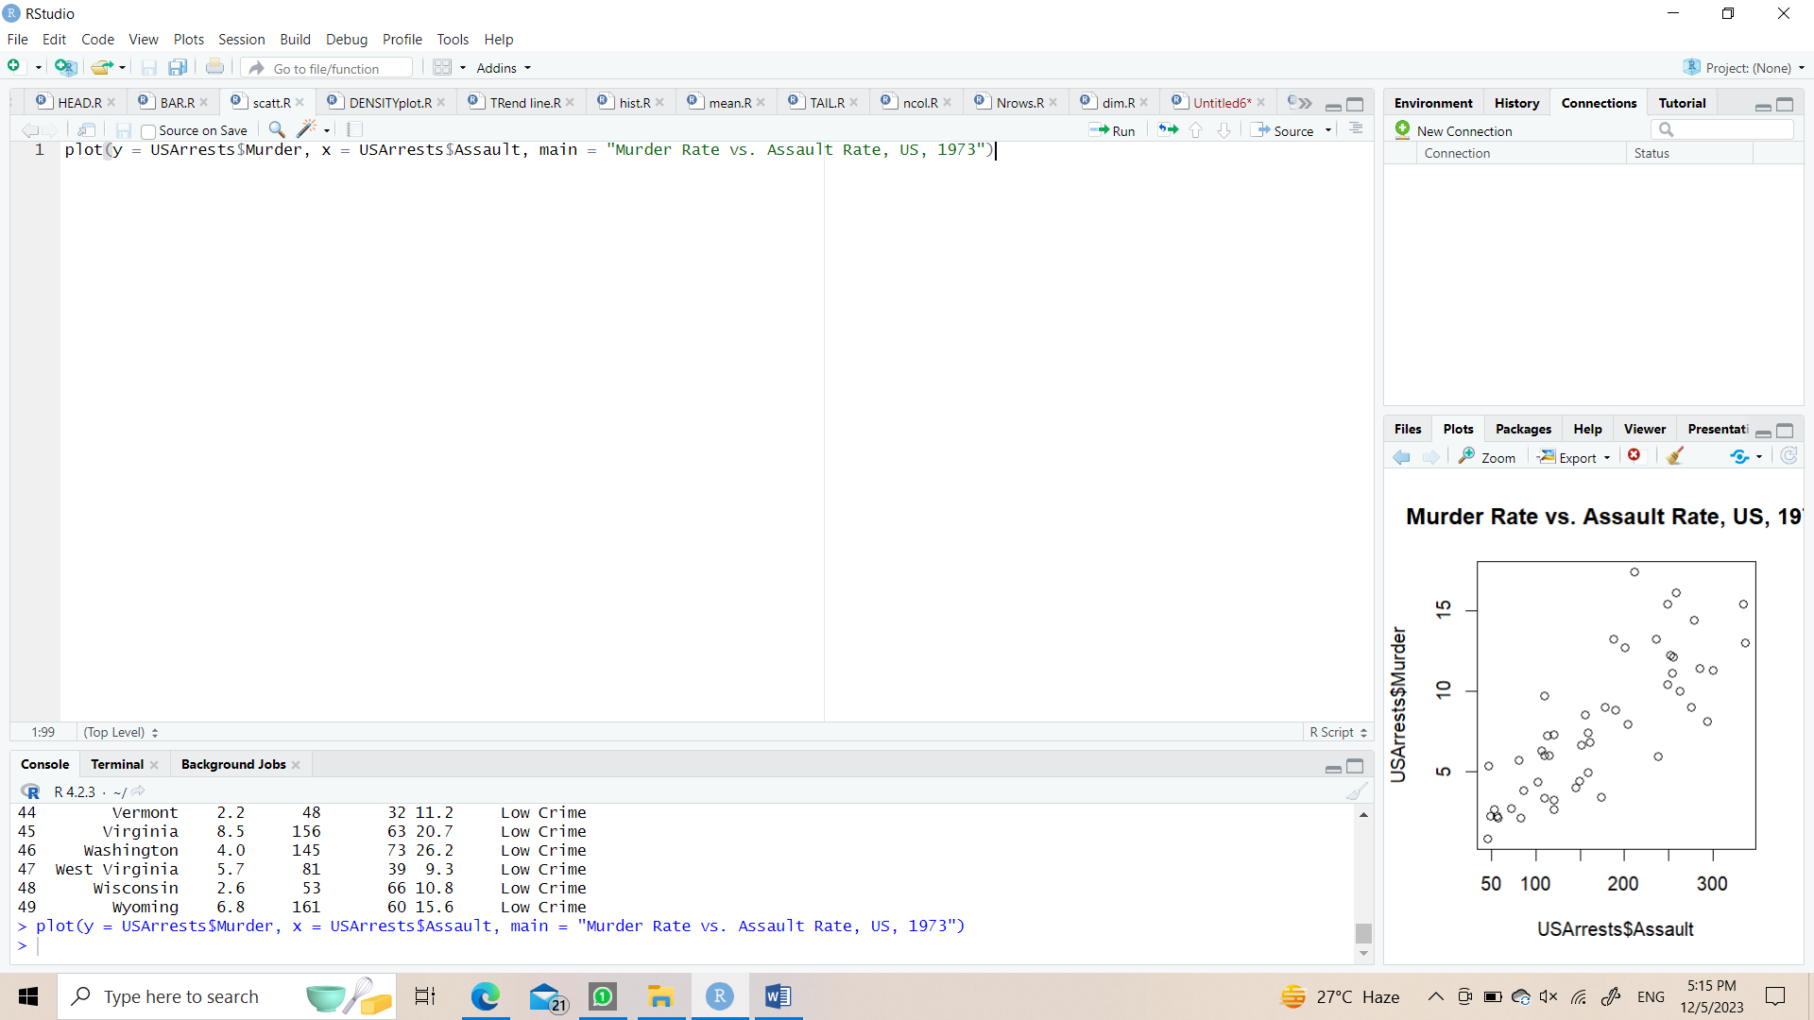
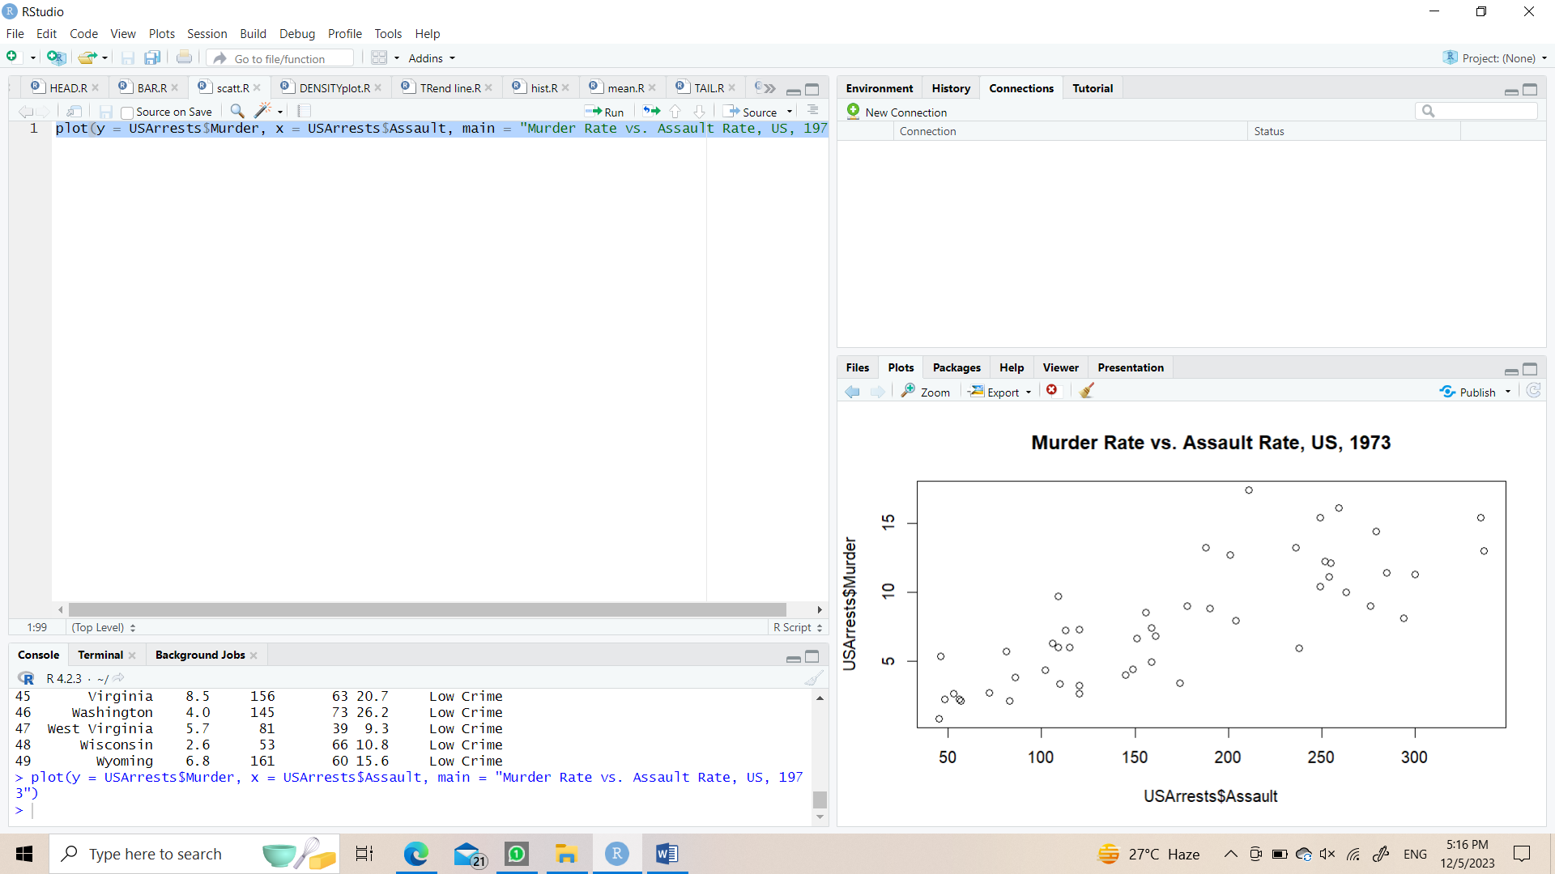
Input:
Outcome:

Slide 27
Conclusion
In conclusion, the examination of the "USArrests" dataset has offered valued insights into the patterns of crime across different states in the United States. Through examining data, we have identified notable variations in arrest rates and crime types, shedding light on potential factors influencing these disparities.
Additionally, the visualization of the dataset has provided a compelling way to comprehend geographical patterns and outliers. Identifying states with unusually high or low arrest rates prompts a deeper examination of the unique circumstances contributing to these deviations.
While this analysis has offered valuable insights, it is crucial to acknowledge the limitations of the dataset.

Slide 28
Thank you

